Slide 1
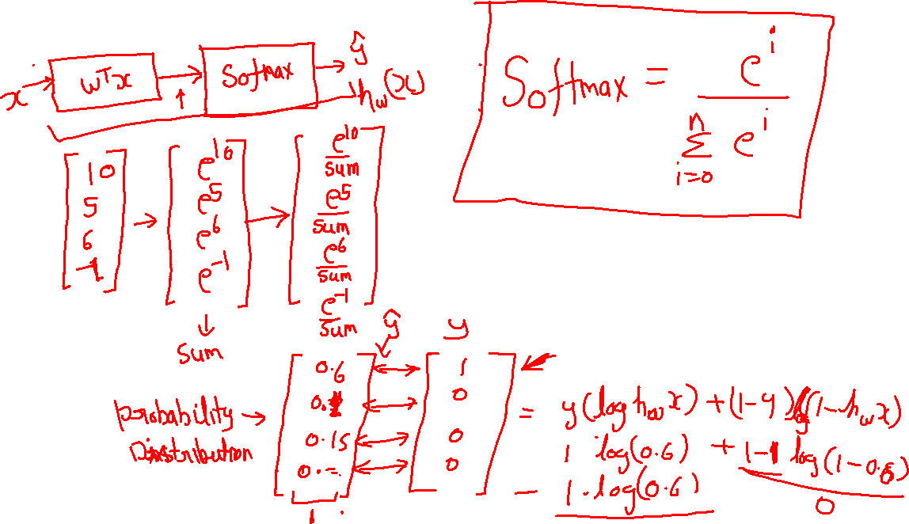
Softmax

Slide 2
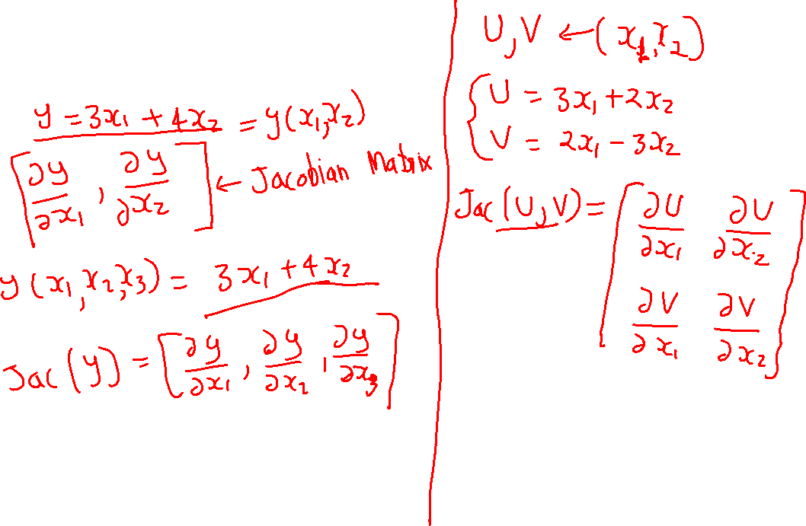
Matrix calculus

Slide 3
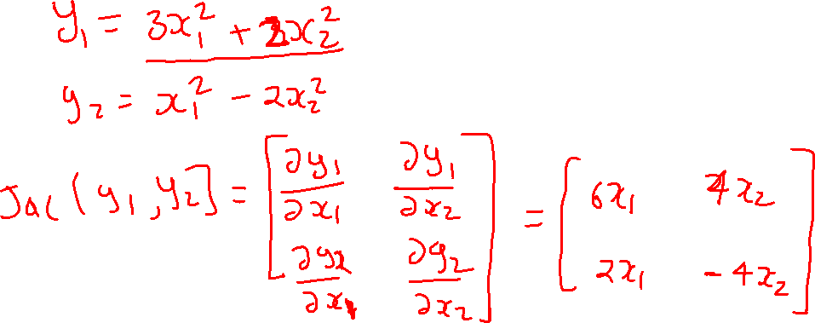
Jacobian Matrix

Slide 4
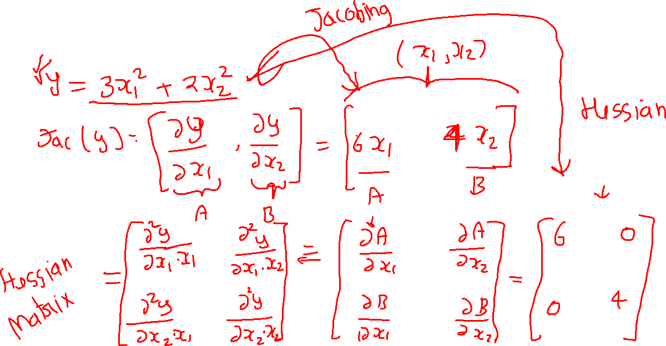
Hessian Matrix

Slide 5
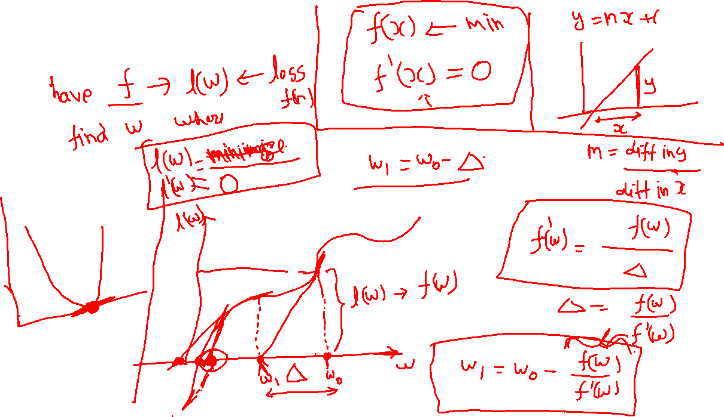
Newton’s Method

Slide 6
